Slide 1
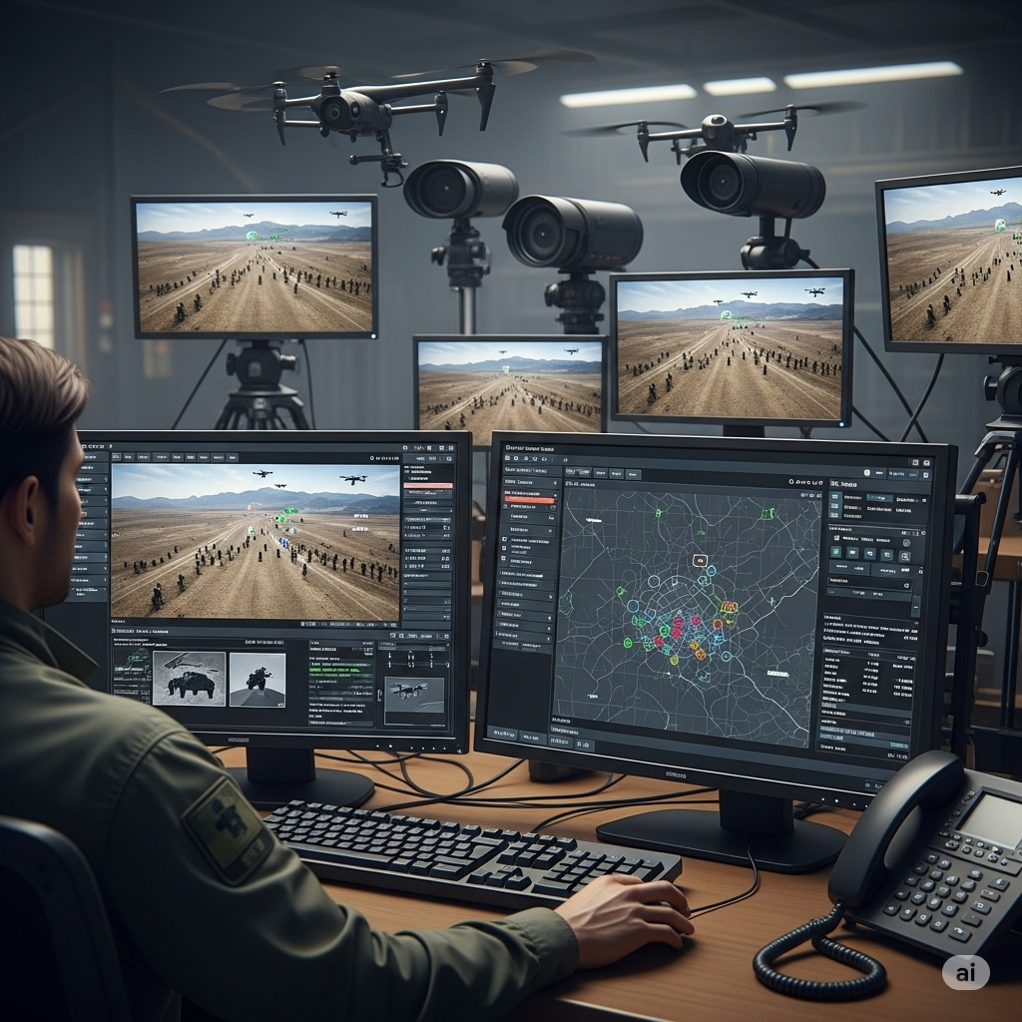

Pattern Based Object Detection for Aerial Reconnassince
K. Sai Venkata Rakesh
Yamir Singh Bamel

Slide 2

Project Overview
This Project aims to develop a prototype system that demonstrates pattern-based object detection in aerial imagery, to identify and track mission-critical assets such as vehicles, air crafts , Bunkers , air craft in reconnassiance footage

Slide 3

Architecture Diagram

Slide 4
ARCHITECTURE
pattern Image
contrastive filter +Edge detection
Segments
SAM Model
Query Image
DinoV2 Large Model
Feature Embeddings
Finding similarity by using metrics like
L2 distance, Cosine Similarity

Slide 5
SAM - SEGMENT ANYTHING MODEL
🔍 Why SAM Is Game-Changing
Universal Segmentation
→ Works on any object, any domain, without retraining
→ Zero-shot generalization: just click, draw a box, or let it auto-detect
Promptable Segmentation
→ Input "prompts" = points, boxes, text, masks
→ It returns high-quality segmentation masks instantly
Massive Training Scale
→ Trained on over 11 million images and 1.1 billion masks
→ Best generalization in segmentation ever seen
Modular + Flexible
→ Can be plugged into any vision pipeline: image editing, robotics, AR, medical, agriculture,
satellites
🚀Process : Image Encoder ---> Prompt Encoder ---> Mask Encoder ---> Post processing

Slide 6
DINOV2 MODEL - MetaAI
🧠 Why DINOv2-Large Is a Disruptor
Self-Supervised Learning at Scale
→ Learns from internet-scale raw image data
→ No labels. Just smart learning from visual patterns
ViT-Based Architecture (Vision Transformer)
→ Uses ViT-L/14 architecture (Large model, 14x14 patch size)
→ Strong inductive bias for long-range spatial relationships
Robust Feature Embeddings
→ Embeddings are semantic, dense, and domain-agnostic
→ Supports tasks from object detection to segmentation to retrieval
Strong Across Modalities
→ Works in medical, satellite, artwork, microscopic, infrared, etc.
→ Outperforms CLIP and SAM in representation quality

Slide 7
DINOV2 MODEL - MetaAI
⚙️ How DINOv2 Works (Simplified Pipeline)
Data Augmentation (Views)
→ Each image is augmented into multiple views (crops, colors, scales)
→ Teaches the model to learn viewpoint-agnostic features
Student-Teacher Setup
→ Two ViT models: teacher (slow-moving) and student (trainable)
→ Student tries to match teacher's output for the same image (different views)
Feature Alignment
→ Through distillation, the model aligns high-level semantics
→ No label needed, just consistency across views
Contrastive + Self-Distillation Losses
→ Avoids collapsing solutions (e.g., same output for all images)
→ Emerges with rich semantic structure in embedding space

Slide 8



